Slide 1
SUMARIZZING Mid-Term Eval Presentation

Slide 2

DATA PROJECT ARCHITECTURE
Question
Data
EDA
Preprocessing
Model Training
Evaluation and Fine-Tuning
Prediction

Slide 3
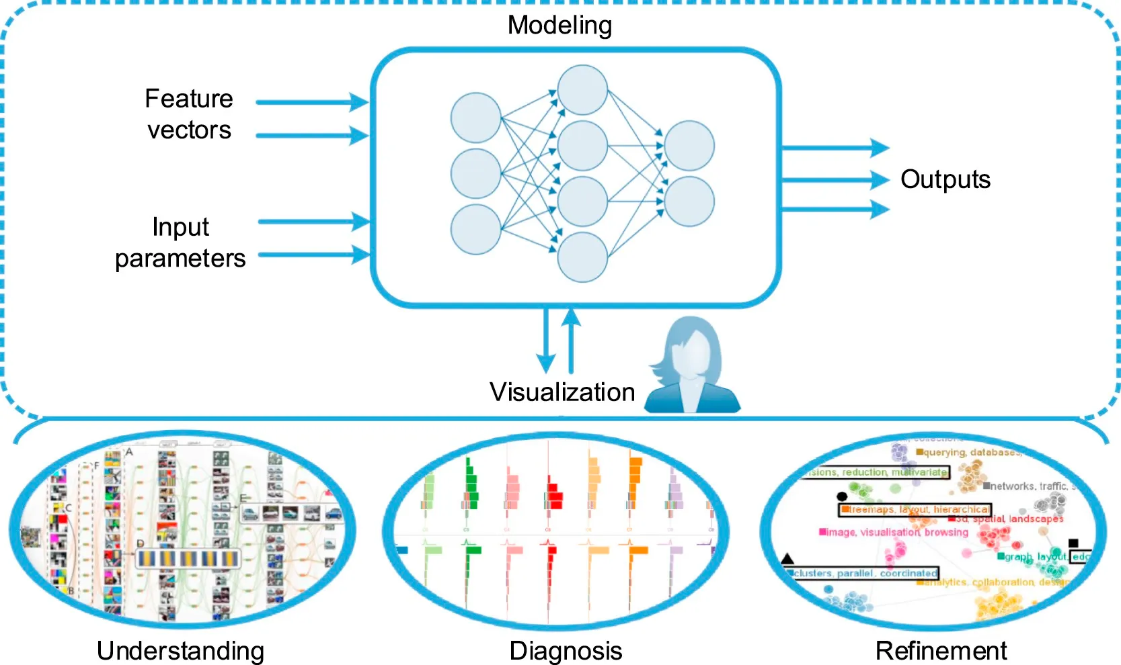

Machine Learning

Slide 4
GETTING STARTED WITH ML
01
02
03
04
Data Collection
Web Scraping using BS4, Selenium
Data Exploration
EDA, Dealing with missing values, PCA, Dealing with imbalanced datasets.
Training the model
Different models, Gradient Descent, Neural Networks, etc.
Evaluating the model
Using metrics such as accuracy, R squared and p values, confusion matrix, etc.

Slide 5
WEB SCRAPING
Web scraping is a technique that helps machine learning systems gather information from websites. It's like having a virtual robot that automatically visits websites, extracts data, and organizes it for analysis. This process is crucial for machine learning because it provides a large amount of data that can be used to train and improve models.

Slide 6
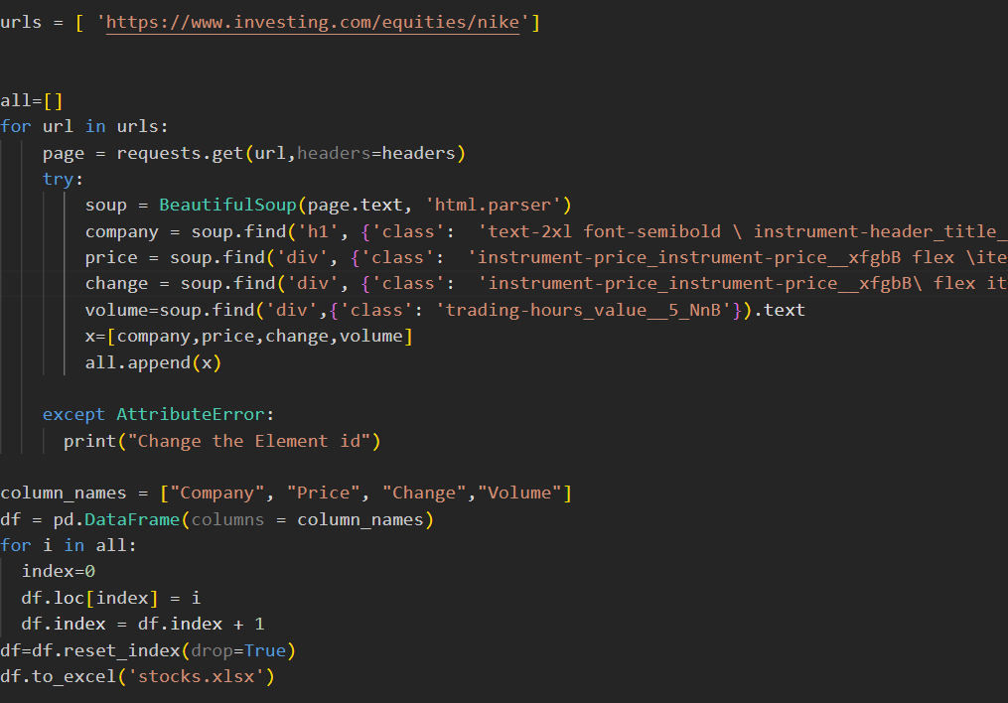
Scraping using BS4
Beautiful Soup 4 is a Python library that makes web scraping easier by providing tools to navigate and extract data from HTML or XML documents. It acts like a helpful assistant that helps you make sense of the messy web pages and find the specific information you need.

Slide 7
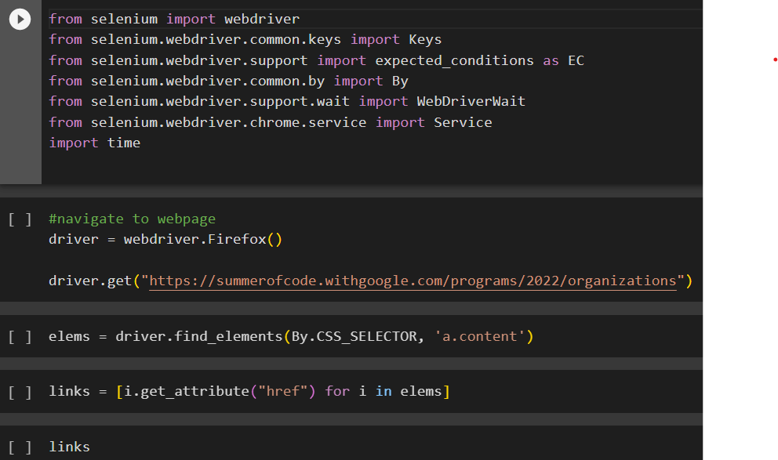
Scraping using Selenium
Selenium is a powerful tool for web scraping that allows you to automate browser interactions. Unlike Beautiful Soup, which focuses on parsing HTML, Selenium simulates user behavior by controlling a web browser programmatically. This capability makes it useful for scenarios where web scraping requires interaction with dynamic web pages, such as handling JavaScript-based elements or navigating through login pages.

Slide 8

Exploratory Data Analysis
Exploratory Data Analysis refers to the critical process of performing initial investigations on data so as to discover patterns, to spot anomalies, to test hypothesis and to check assumptions with the help of summary statistics and graphical representations.

Slide 9
STEPS IN EDA
01
04
02
05
03
06
Data cleaning
Feature engineering
Handle missing values, outliers, inconsistencies, and formatting issues.
Deriving new features or transforming existing ones to enhance the predictive power of the dataset
Data visualization
Dimensionality reduction
Creating visual representations to explore the distribution, relationships, and patterns within the data.
Techniques such as principal component analysis (PCA) are used.
Descriptive statistics
Outlier detection
Calculating summary statistics such as mean, median, standard deviation, etc.
Identifying and handling outliers that may significantly impact the analysis or modeling process

Slide 10
PCA (PRINCIPAL COMPONENT ANALYSIS)
It is a dimensionality reduction technique used in data analysis and machine learning to transform a dataset into a lower-dimensional space while preserving the most important information or patterns in the data.
The main objective of PCA is to identify the directions, called principal components, along which the data varies the most. These principal components are a set of orthogonal axes that capture the maximum variance in the dataset.
The first principal component accounts for the largest amount of variation, followed by the second principal component, and so on.

Slide 11
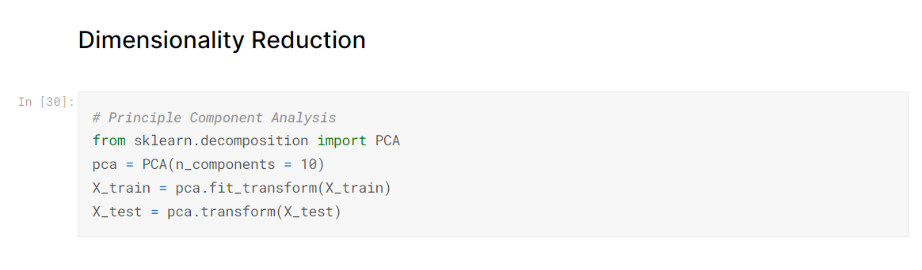
PCA
By reducing the dimensionality of the dataset, PCA can simplify subsequent analysis and modeling tasks while preserving the most important information.
PCA is widely used for various purposes, such as data visualization, feature extraction, noise reduction, and data compression.

Slide 12
03
Training the Model
Training a model refers to the process of teaching a machine learning algorithm or model to recognize patterns and make predictions based on input data. It involves providing the model with a large dataset containing examples of inputs and their corresponding outputs, and allowing the model to learn from this data through iterative adjustments to its internal parameters.

Slide 13
Types of Models
Supervised Learning
Supervised learning is the type of machine learning in which model is trained using well "labelled" training data, and on basis of that data, model predicts the output. The labelled data means some input data is already tagged with the correct output.
Unsupervised Learning
In this models are not supervised using datasets. Instead , model itself finds the hidden patterns and insights from the given data just like a human brain does.
Reinforcement Learning
Reinforcement Learning is a feedback-based Machine learning technique in which an agent learns to behave in an environment by performing the actions and seeing the results of actions. For each good action, the agent gets positive feedback, and for each bad action, the agent gets negative feedback or penalty

Slide 14
Supervised Learning Algorithms
Regression algorithms
Regression analysis is a statistical method to model the relationship between a dependent (target) and independent (predictor) variables with one or more independent variables.
Classification algorithms
The Classification algorithm is a Supervised Learning technique that is used to identify the category of new observations on the basis of training data.

Slide 15
Regression Algorithms
Regression analysis helps us to understand how the value of the dependent variable is changing corresponding to an independent variable when other independent variables are held fixed.
Dependent variable or the target variable is predicted using the independent variables and a pattern is formulated for evaluating this target value using some statistical methods .
Different types includes linear regression , logistic regression , decision tree regression , random forest regression , etc.

Slide 16
Preprocessing required in Regression Algorithms
Outliers: Outlier is an observation which contains either very low value or very high value in comparison to other observed values. An outlier may hamper the result, so it should be avoided.
Multicollinearity: If the independent variables are highly correlated with each other than other variables, then such condition is called Multicollinearity. It should not be present in the dataset, because it creates problem while ranking the most affecting variable.
Underfitting and Overfitting: If our algorithm works well with the training dataset but not well with test dataset, then such problem is called Overfitting. And if our algorithm does not perform well even with training dataset, then such problem is called underfitting.

Slide 17
Classification Algorithms
In Classification, a program learns from the given dataset or observations and then classifies new observation into a number of classes or groups. Such as, Yes or No, 0 or 1, Spam or Not Spam, cat or dog, etc.
Classes can be called as targets/labels or categories
Unlike regression, the output variable of Classification is a category, not a value, such as "Green or Blue", "fruit or animal", etc.
Classification model can be implemented very well using Decision trees or Random forest algorithm where classification takes place at each leaf node.

Slide 18
SMOTE
The data needs to be analyzed to determine the right parameters to be included for training the model
Techniques like SMOTE and ADASYN are used to make a balanced dataset
SMOTE creates artificial datapoints for minority class in order to reduce imbalance in data
For example in case of ATM fraud , SMOTE is used to create data points in favor of fraud transactions in order to make the data suitable for training.
The data we get maybe imbalanced

Slide 19
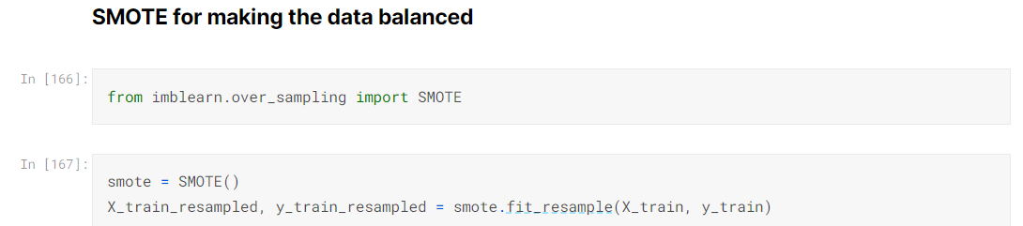
SMOTE
SMOTE has many applications in practical projects like cancer prediction models where the probability of a positive dataset is very low
In such cases , in order to prevent inclination of model towards negative outcome , we need to create synthetic data points for minority class namely , the positive value for the outcome , which can be done using SMOTE

Slide 21
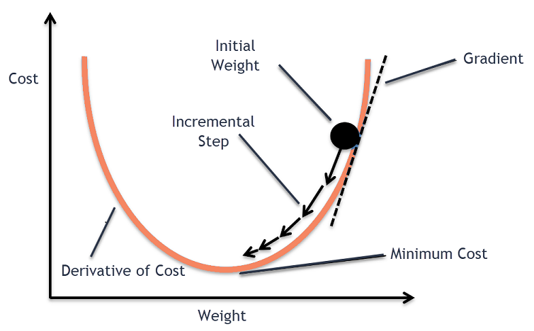
Gradient descent
Gradient descent is an optimization algorithm commonly used in machine learning and deep learning to minimize the cost or loss function of a model. It is an iterative process that adjusts the parameters of a model in the direction of steepest descent of the cost function.

Slide 22
STEPS IN GRADIENT DESCENT
01
04
02
05
03
06
Initialization
Gradient Calculation
The algorithm begins by initializing the model's parameters with some initial values.
The gradient of the cost function with respect to each parameter is calculated. The gradient represents the direction and magnitude of the steepest ascent or descent of the cost function.
Forward Pass
Parameter Update:
A forward pass is performed through the model to compute the predicted output given the current parameter values.
The parameters are updated by subtracting a fraction of the gradient from their current values.
Cost/Loss Calculation:
Repeat
The cost or loss function is computed using the predicted output and the actual output.
The loss function measures the discrepancy between the predicted and actual values.
Steps 2 to 5 are repeated iteratively until convergence or a stopping criterion is reached

Slide 23
Evaluating The Model
04
Model evaluation in machine learning is a critical step to assess the performance and effectiveness of a trained model. It involves quantifying how well the model generalizes to unseen data and how accurately it makes predictions.

Slide 24
METRICS OF EVALUATION
Accuracy
Measures the proportion of correctly classified instances to the total number of instances, providing an overall measure of correctness.
R² Value
Represents the proportion of the variance in the dependent variable that can be explained by the model, with higher values indicating a better fit.
Confusion Matrix
A confusion matrix is a table that summarizes the performance of a classification model by showing the counts of true positive, true negative, false positive, and false negative predictions.

Slide 25
METRICS OF EVALUATION
Precision
Precision is the ratio of true positives to the summation of true positives and false positives. It basically analyses the positive predictions.
Sensitivity
Calculated as the ratio of true positive predictions to the sum of true positive and false negative predictions.
F1 Score
Represents the harmonic mean of precision and recall. Provides a balanced measure of the model's performance.

Slide 26
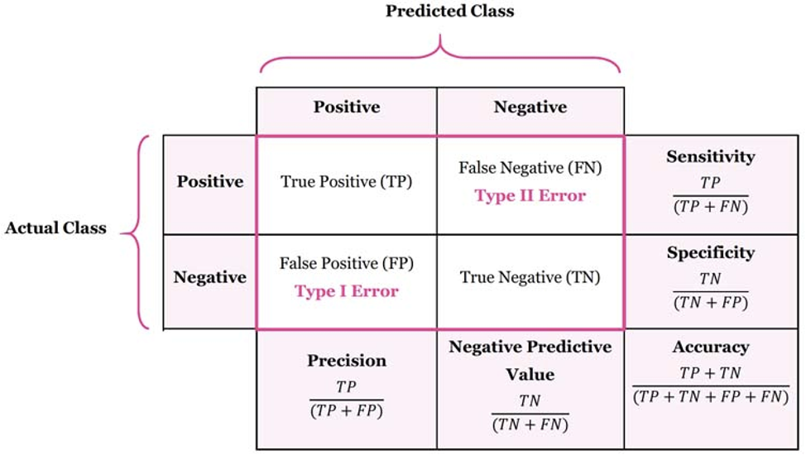

Slide 27
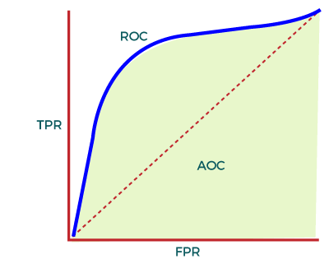
METRICS OF EVALUATION
AUC-ROC
ROC represents a graph to show the performance of a classification model at different threshold levels. Plots sensitivity against (1-specificity) . AUC calculates the performance across all the thresholds and provides an aggregate measure.

